Slide 1


Network Topology Session No.: 2 Course Name: Data Communication and Networking Course Code: R1UC406B Instructor Name: ASHWANI KUMAR

Slide 2
Learning Outcomes
At the end session students will be able to
Learning Outcome 1: Identify the Computer Network Topologies
Learning Outcome 2: Apply topology in networking

Slide 3
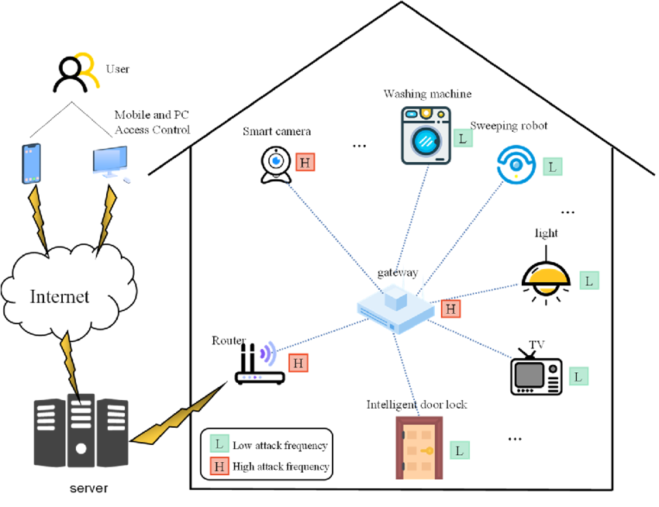
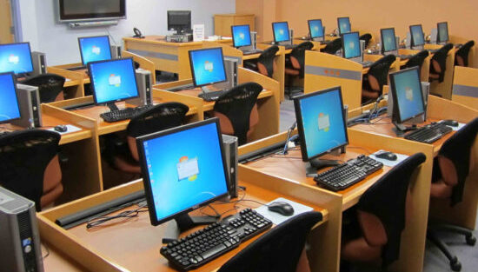
Identify the Differences in the following network

Slide 4
Network Topology
Network topology refers to the physical or logical arrangement of network devices and how data flows between them.
The choice of topology affects performance, scalability, and reliability.

Slide 5
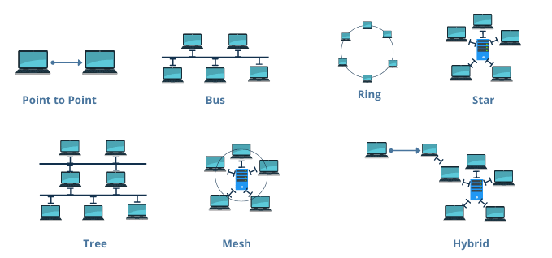
Basic Idea of Topology
Mesh Topology
Bus Topology
Star Topology
Ring Topology
Tree Topology
Hybrid Topology

Slide 6
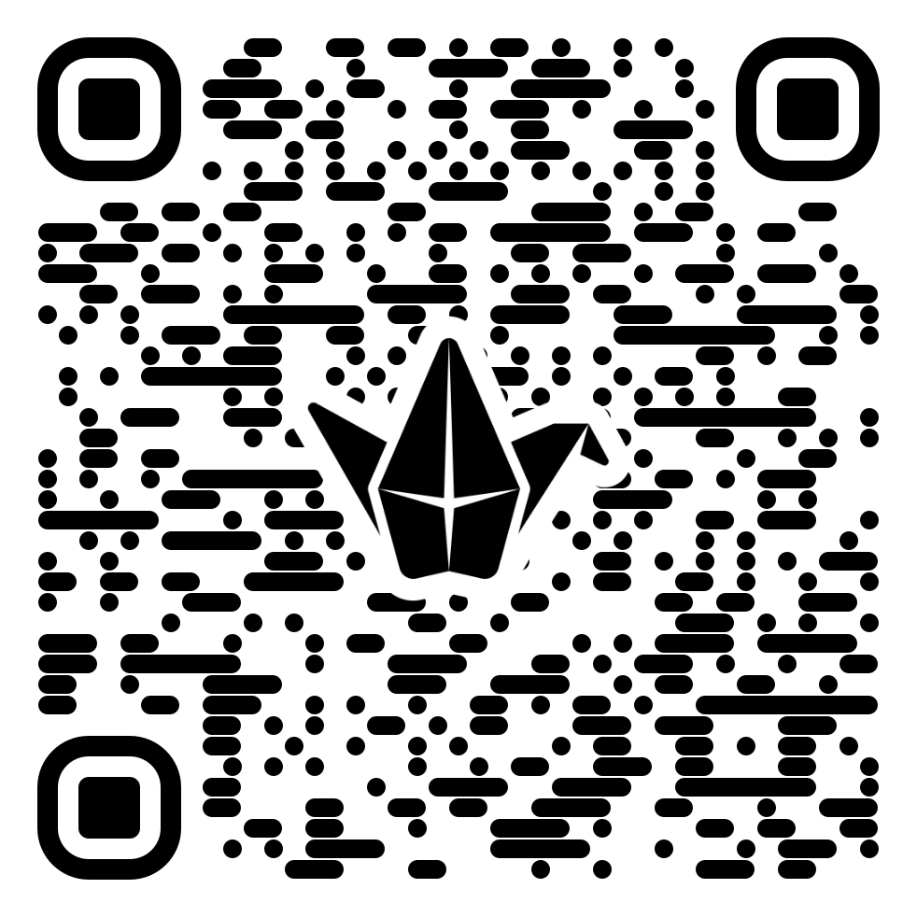
Group Activity
Each table(group) have to discuss & share the properties, diagram , advantages & disadvantages of the assigned topology.
Group 1/7 : Star
Group 2/8 : Mesh
Group 3/9 : Bus
Group 4/10 : Ring
Group 5/11 : Tree
Group 6/12 : Hybrid

Slide 7
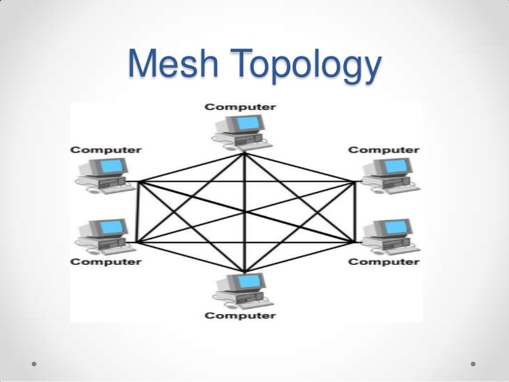
Mesh Topology
Every link is dedicated point-to-point link
The term dedicated means that the link carries traffic only between the two devices it connects

Slide 8
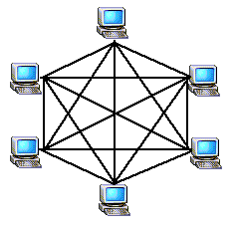
Mesh Topology
Mesh
To link n devices fully connected mesh has: n ( n - 1) / 2 physical channels (Full-Duplex)
Every Device on the network must have n - 1 ports

Slide 9

Mesh Topology
Mesh
Example:
8 devices in mesh has links: n(n-1) / 2
number of links = 8 (8-1)/2 = 28
number of ports per device = n – 1 = 8 –1 = 7

Slide 10
Mesh Topology
Each device connects to multiple others for redundancy.
Advantages:
• Highly reliable and fault-tolerant
• No single point of failure
• Supports high traffic loads
Disadvantages:
• Very expensive due to cabling
• Complex to set up and maintain

Slide 11
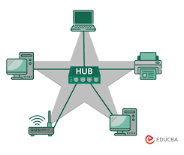
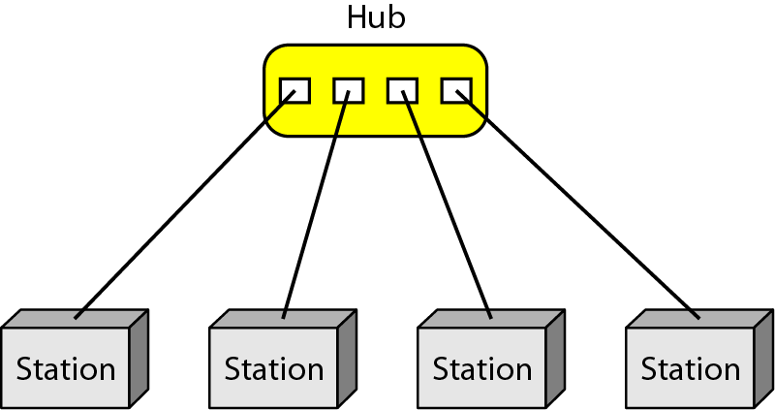
Star Topology
Star:
Dedicated point-to-point to a central controller (Hub)
No direct traffic between devices
The control acts as an exchange

Slide 12
Star Topology
All devices are connected to a central hub or switch.
Advantages:
• Easy to manage and troubleshoot
• High performance
• Failure of one device does not affect the rest
Disadvantages:
• Failure of the central hub disrupts the entire network
• Expensive due to extra cabling

Slide 13
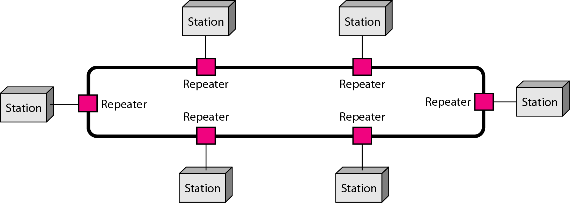
Ring Topology
Ring
Each device has dedicated point-to-point connection with only the two devices on either side of it
A signal is passed along the ring in one direction from device to device until it reaches its destination
Each devices incorporates a Repeater

Slide 14

Ring Topology
Ring
Advantages
Easy of install and reconfigure
Connect to immediate neighbors
Move two connections for any moving (Add/Delete)
Easy of fault isolation
Disadvantage
Unidirectional
One broken device can disable the entire network. This weakness can be solved by using a dual ring or a switch capable of closing off the break

Slide 15
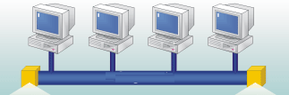
Bus Topology
Bus
It is multipoint
One long cable acts as a backbone
Used in the design of early LANS, and Ethernet LANs

Slide 16
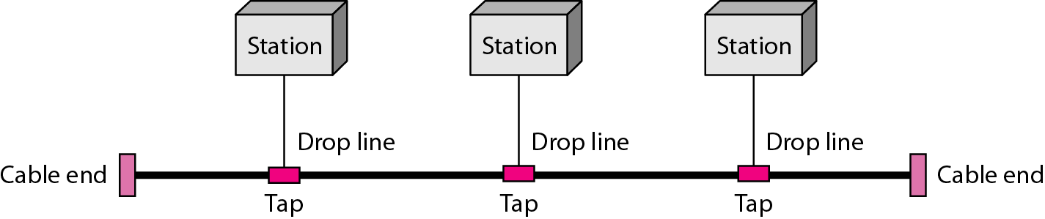
Bus Topology
Bus
Nodes connect to cable by drop lines and taps
Signal travels along the backbone and some of its energy is transformed to heat
Limit of number of taps and the distance between taps

Slide 17

Bus Topology
Bus
Advantages
Ease of installation
Less cables than mesh, star topologies
Disadvantages
Difficult reconnection and fault isolation ( limit of taps)
Adding new device requires modification of backbone
Fault or break stops all transmission
The damaged area reflects signals back in the direction of the origin, creating noise in both directions

Slide 18
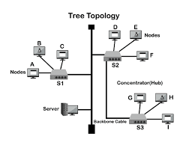
Tree Topology
A hierarchical structure combining multiple star topologies.
Advantages:
• Scalable for large networks
• Easy to manage in a structured way
Disadvantages:
• If the main backbone fails, the network collapses
• Complex and costly

Slide 19
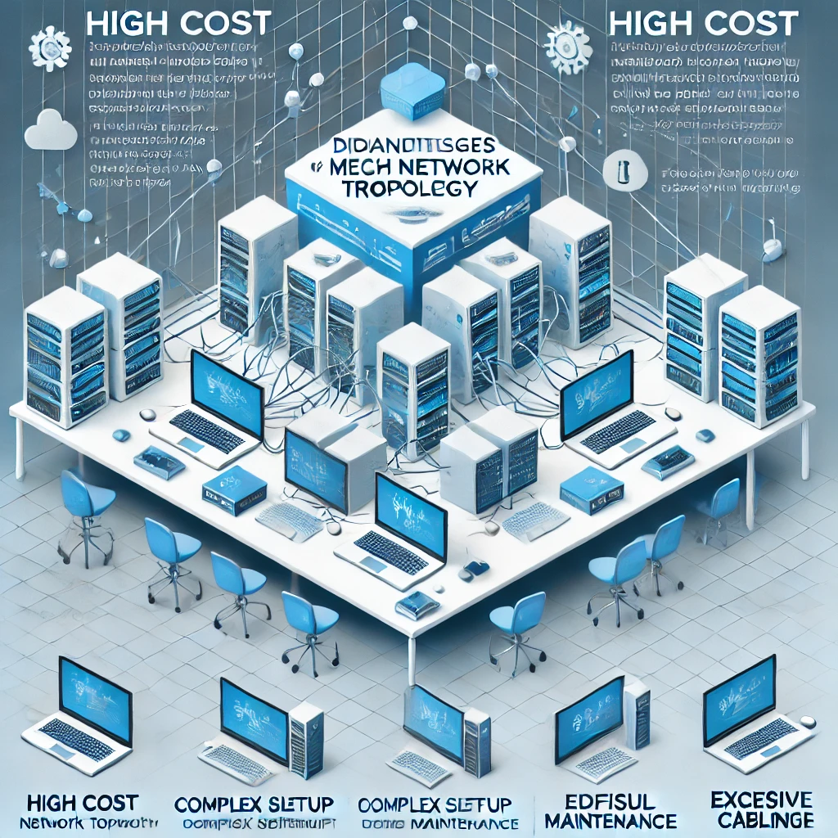
Identify Topology ( Image 1)

Slide 20

Scan the QR Code

Slide 21
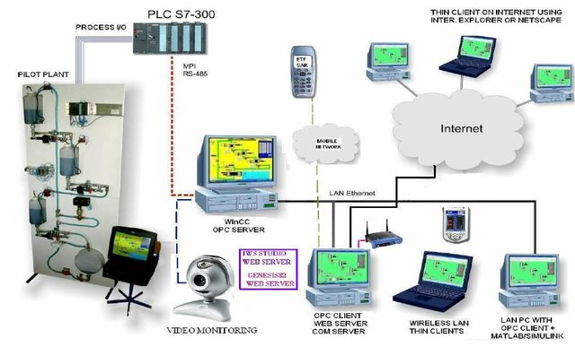
I Identify the network topology in given image 2

Slide 22
Scan the QR Code

Slide 23
Real Life Applications
Share some examples where the above topologies can be implemented in real life

Slide 24
Real Life Applications
Topology | Real-Life Applications
Star | Home networks, small offices, Ethernet LANs.
Bus | Legacy networks, industrial systems, CCTV.
Ring | Token Ring networks, FDDI, telecommunications.
Mesh | Military networks, IoT, smart cities.
Tree | Enterprise networks, campus networks, ISPs.
Hybrid | Large enterprises, data centers, telecommunications.

Slide 25
Summary
The choice of topology depends on factors such as cost, scalability, reliability, and ease of maintenance. A well-planned network topology ensures efficient data flow, minimizes downtime, and enhances overall network performance.

Slide 26
Summary
Topology | Performance | Scalability | Reliability
Star | High (small-medium) | Easy to scale | High (if hub/switch is reliable)
Bus | Low to moderate | Poor | Low
Ring | Moderate to high | Moderate | Moderate (bidirectional improves reliability)
Mesh | High | High (but complex) | Very high
Tree | High | High | High
Hybrid | High | High | High

Slide 27
Attainment
Learning Outcome 1: Identify the Computer Network Topologies
Learning Outcome 2: Apply topology in networking

Slide 28
In next class
Assignment:
Assignment of todays class is given on LMS. Attempt the quiz on time.
In next class we will study: Categories of Networks , Internet and Protocols, Standards and Standard Organization
Go through LMS for pre class material, attempt the Pre- study quiz given on LMS.

